Slide 1
Data repositories
Henning Hermjakob
Rafael Jimenez

Slide 2
Data repositories subproject
Lead | EMBL-EBI (Henning Hermjakob)
Members | EMBL-EBI, ELIXIR UK
Delivery | Starting from 1 January 2017 for a period of 12 months
Funding | ELIXIR Bioschemas implementation study (7PMs)

Slide 3




Data repositories
…

Slide 4
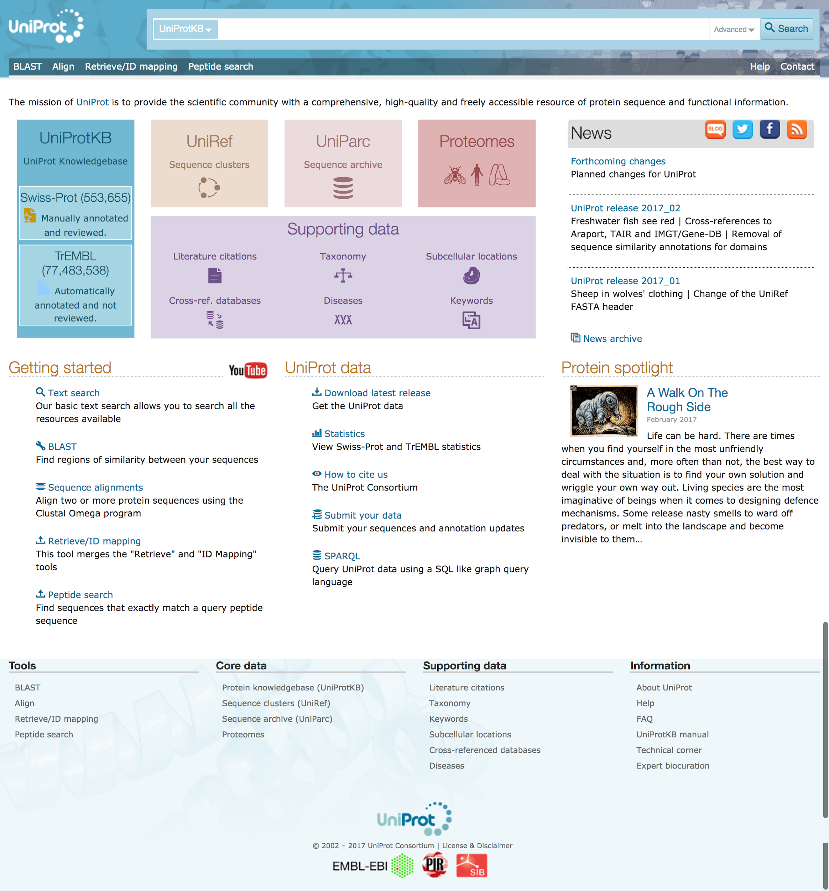
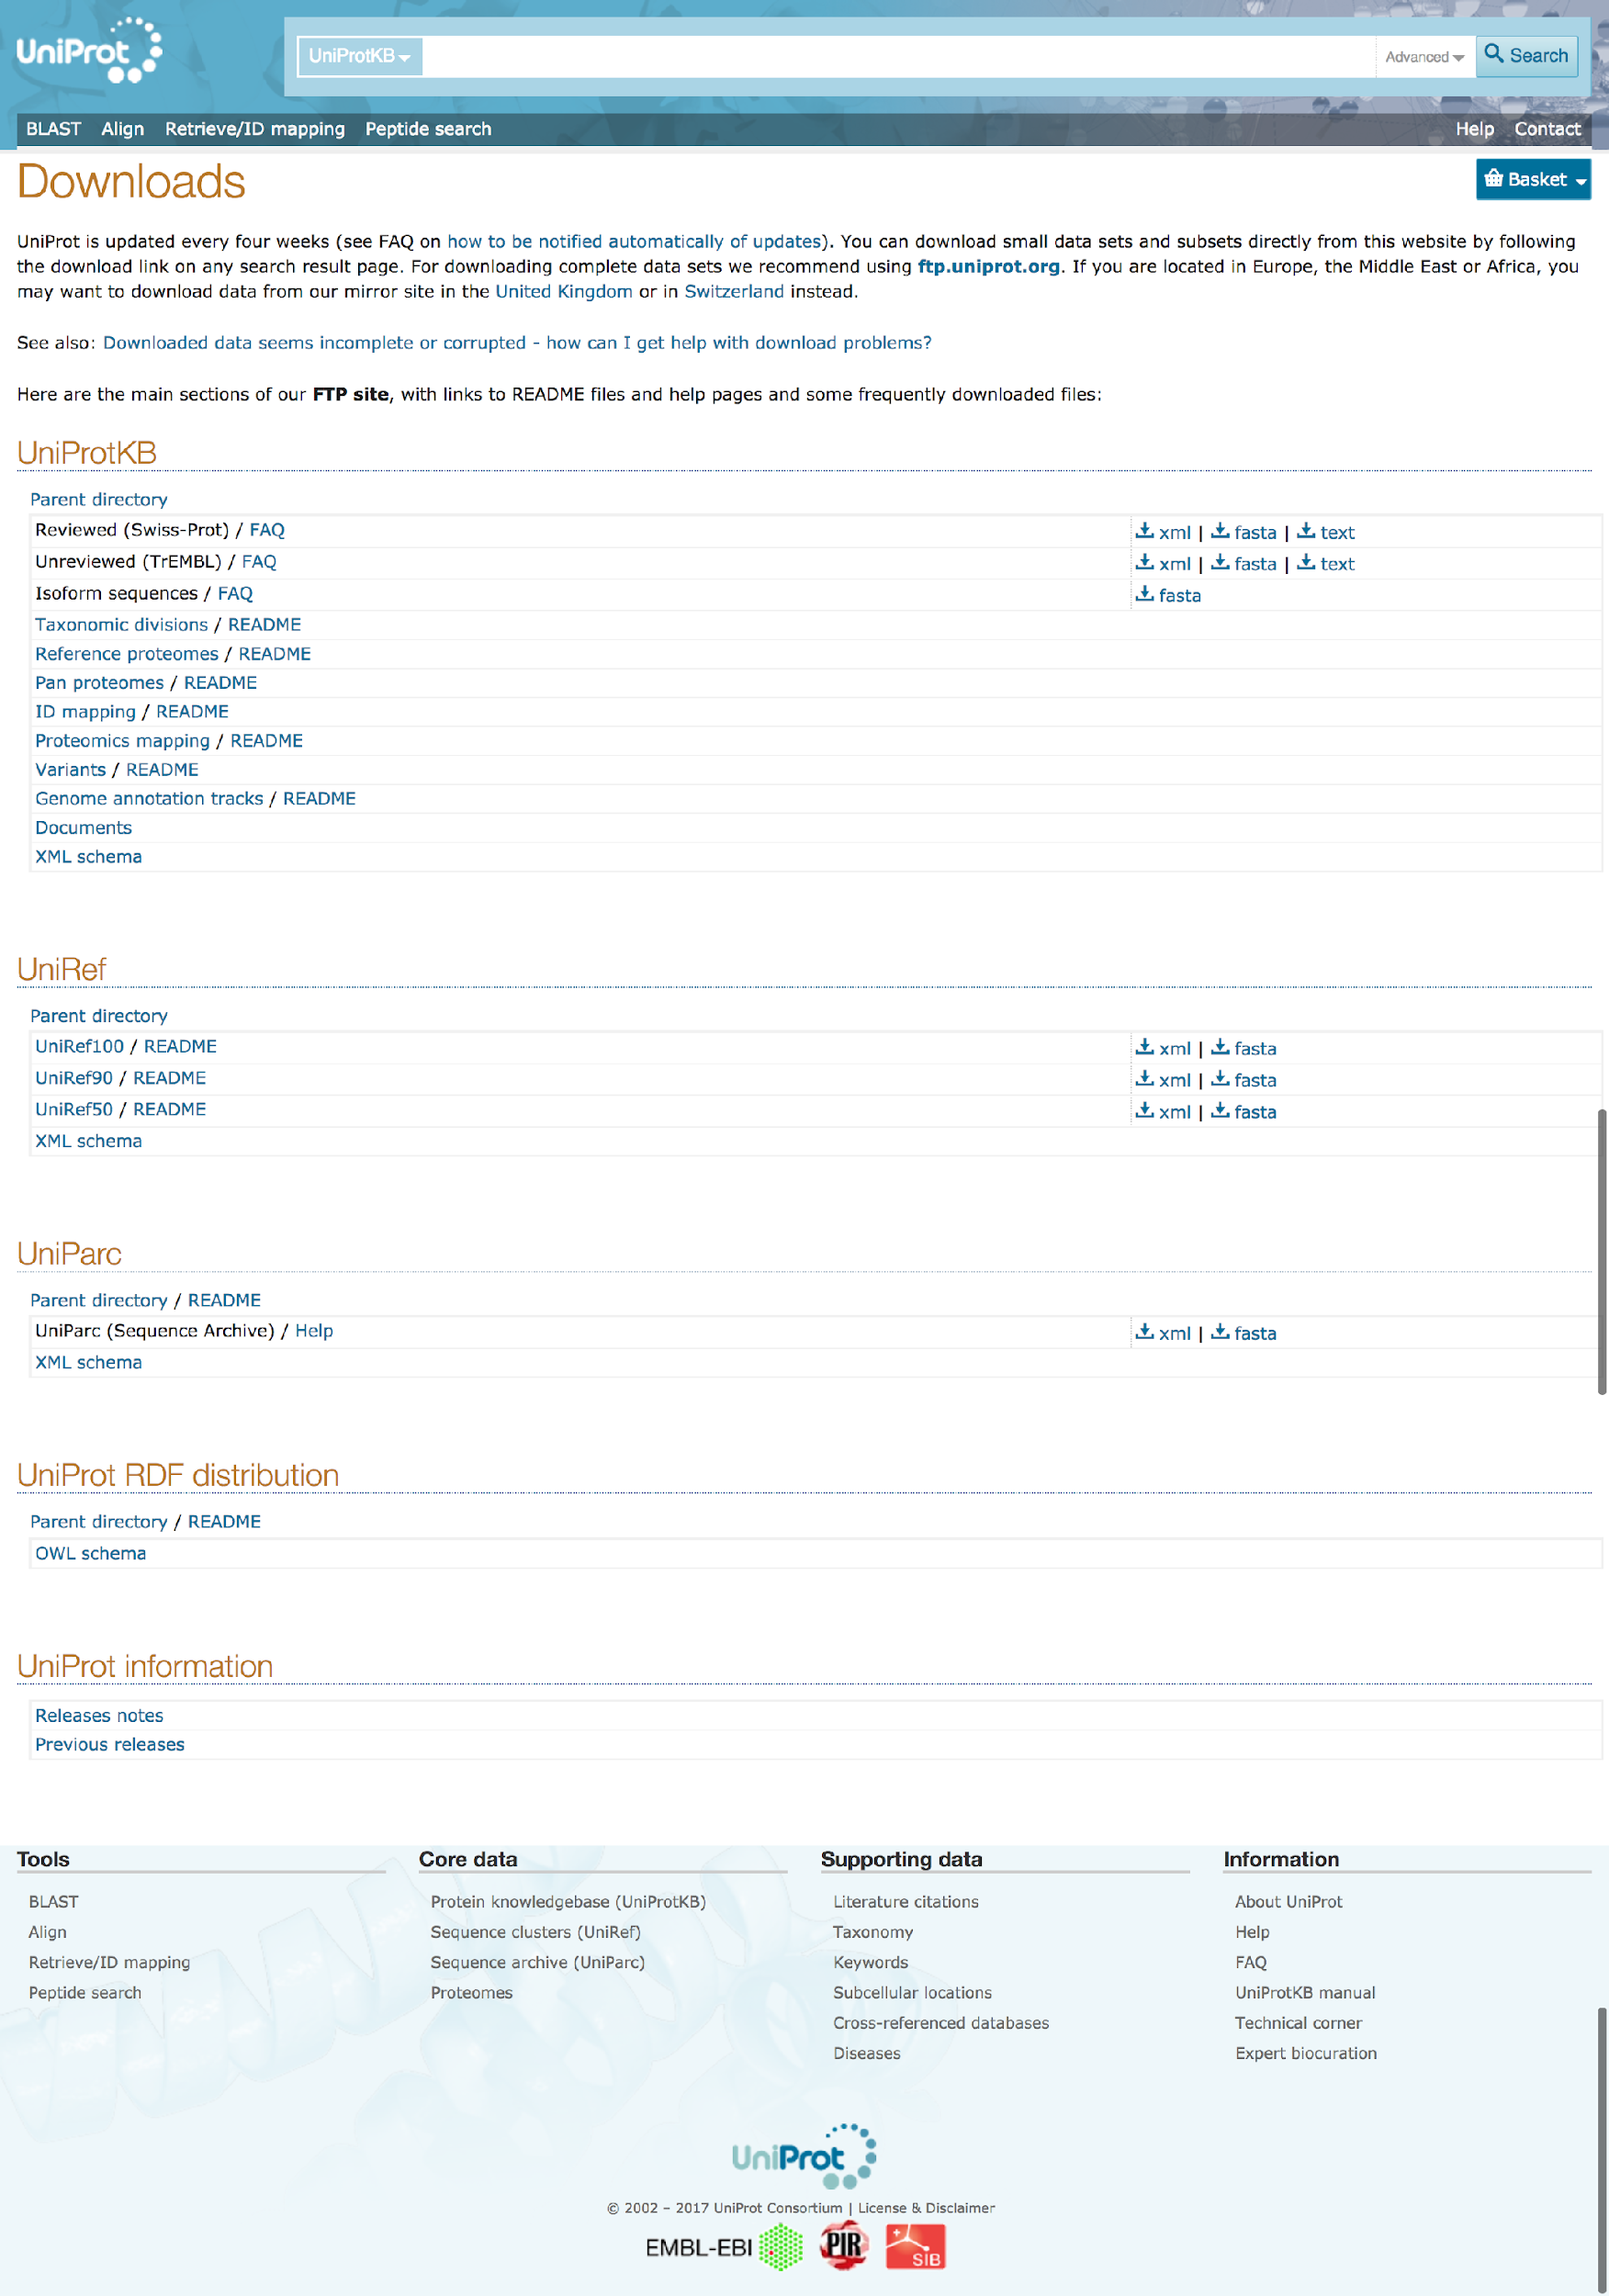
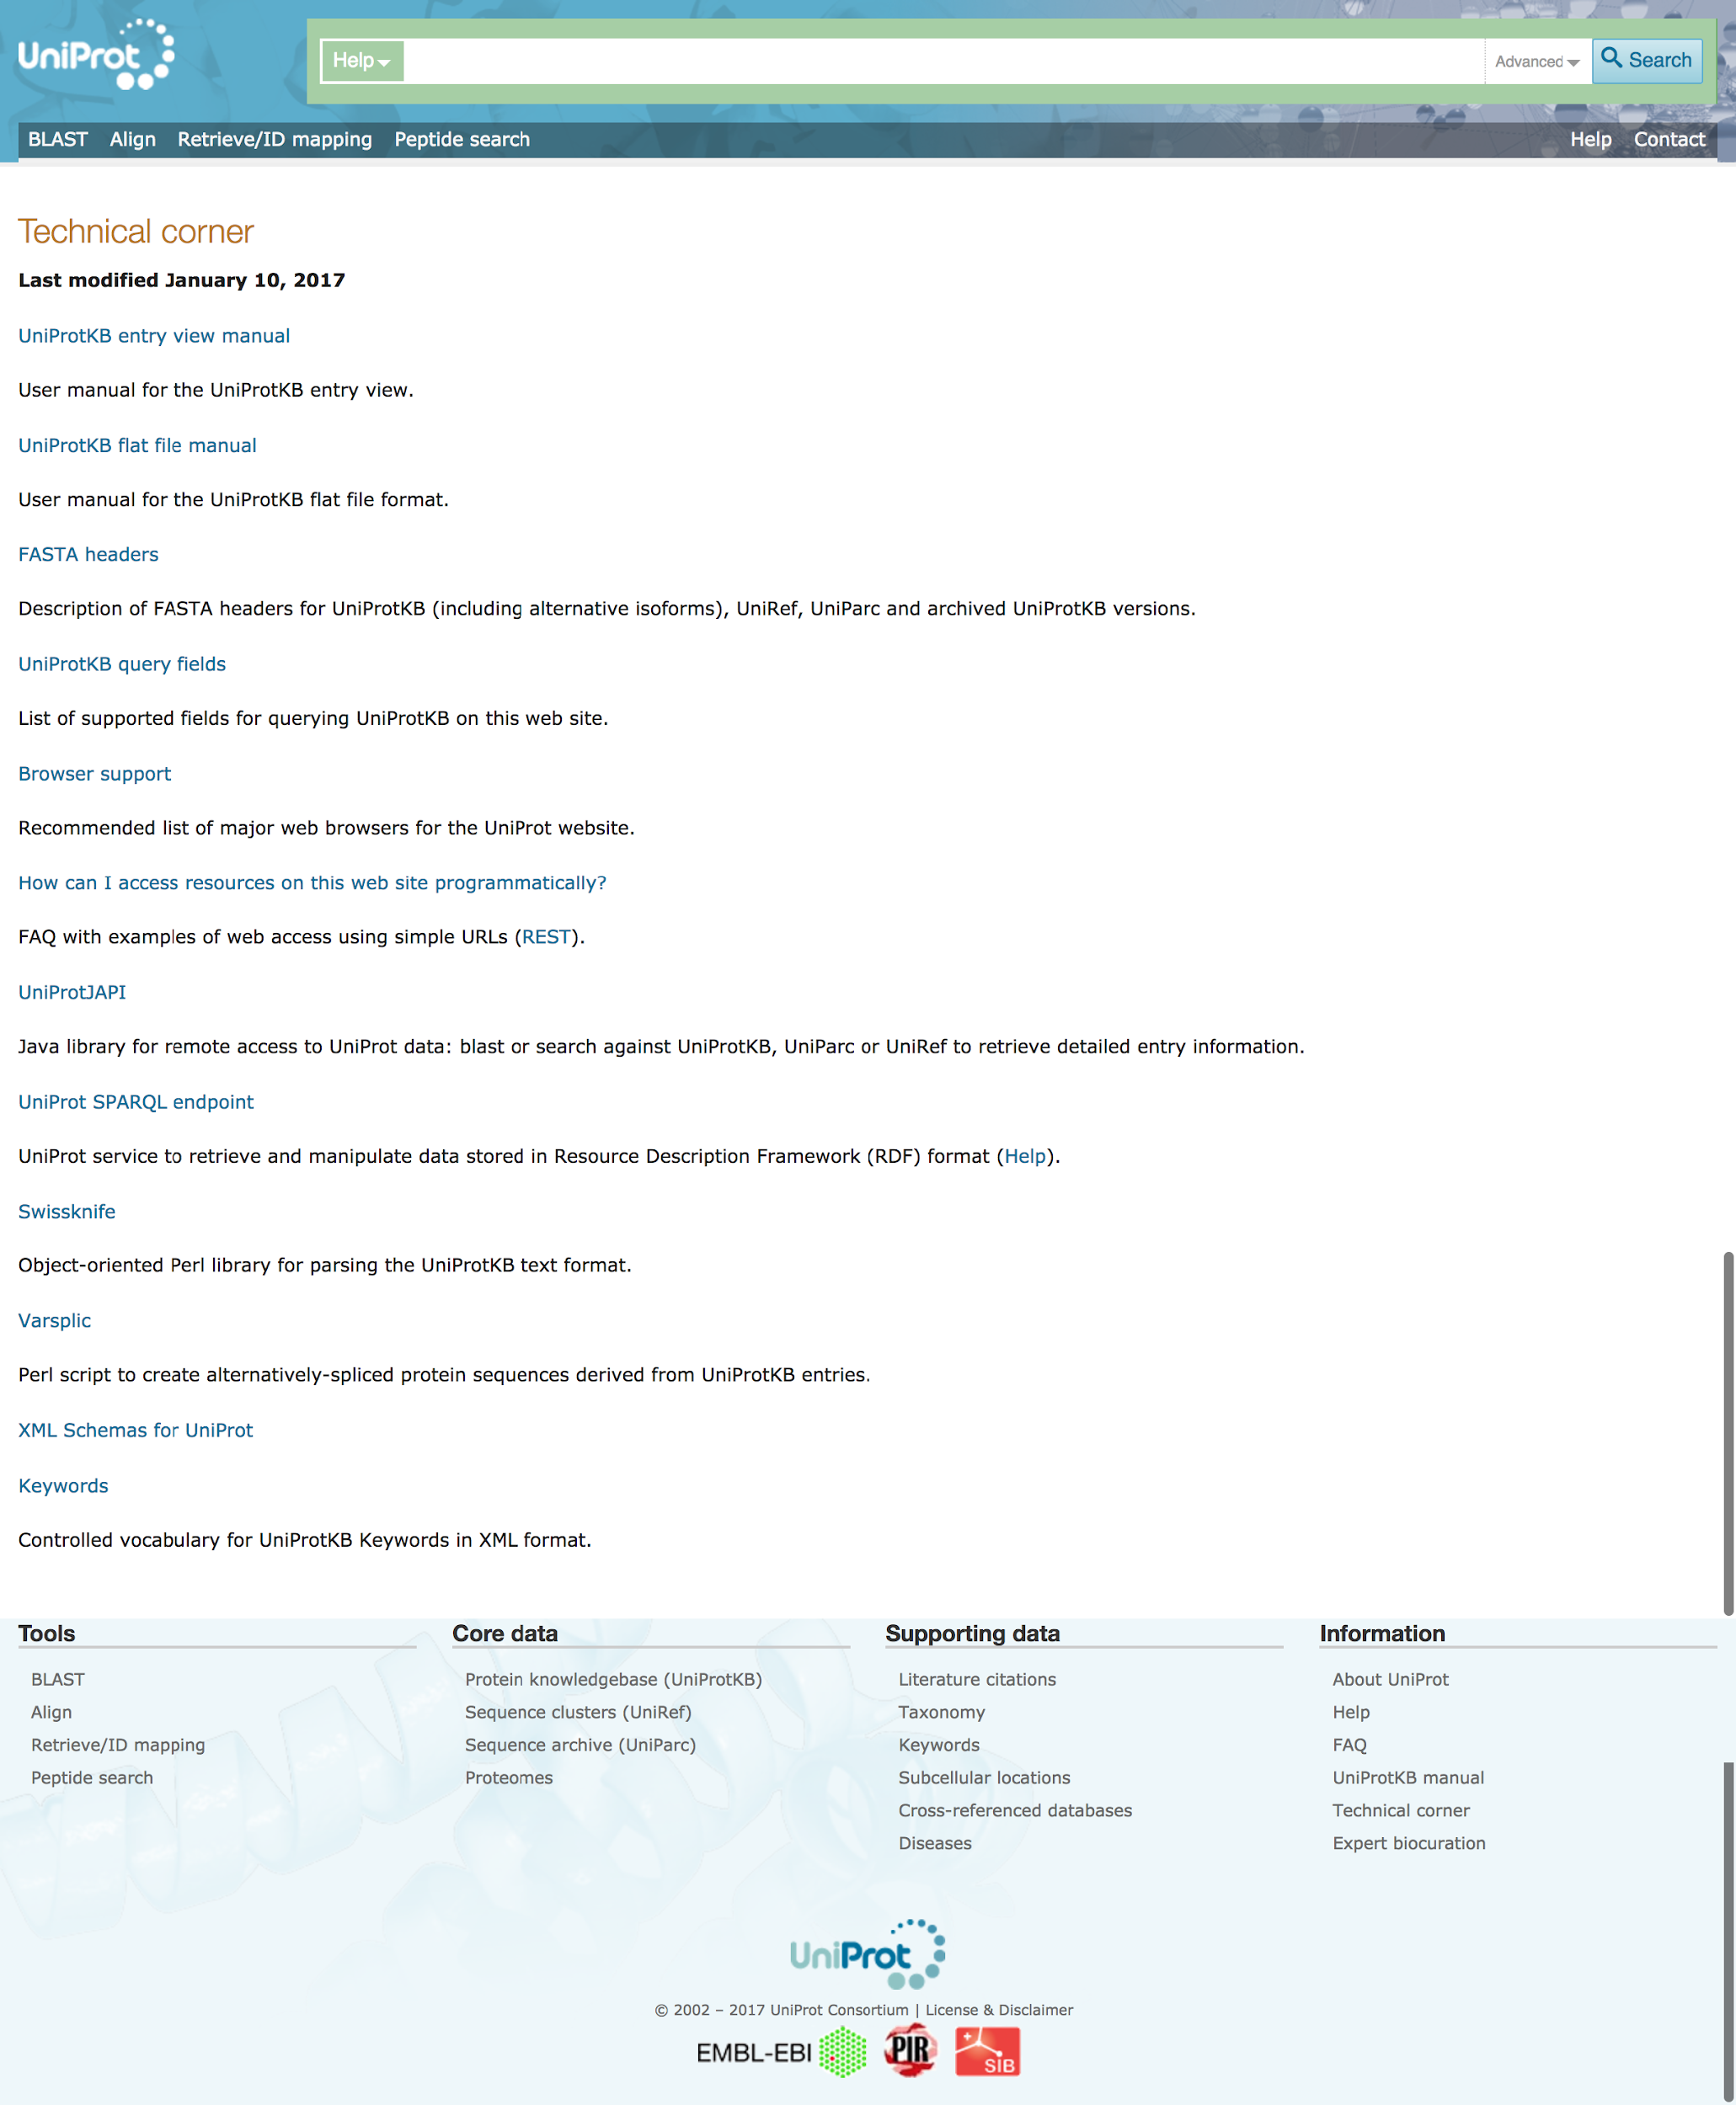
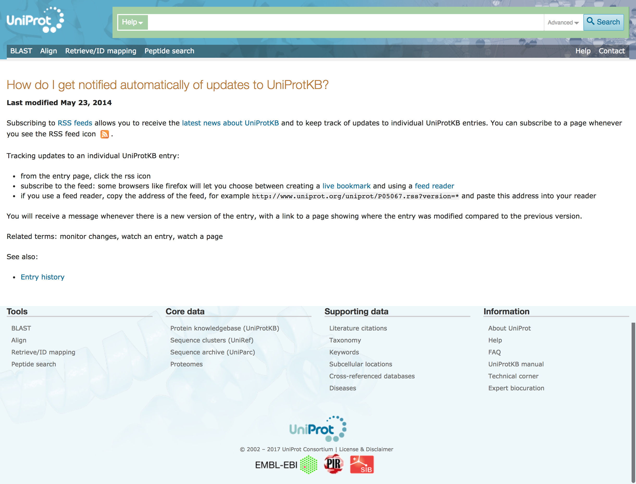
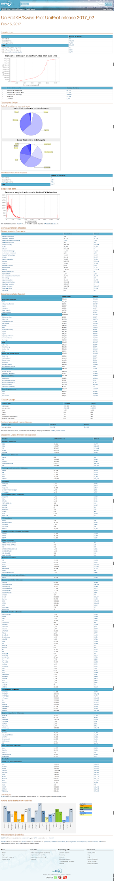
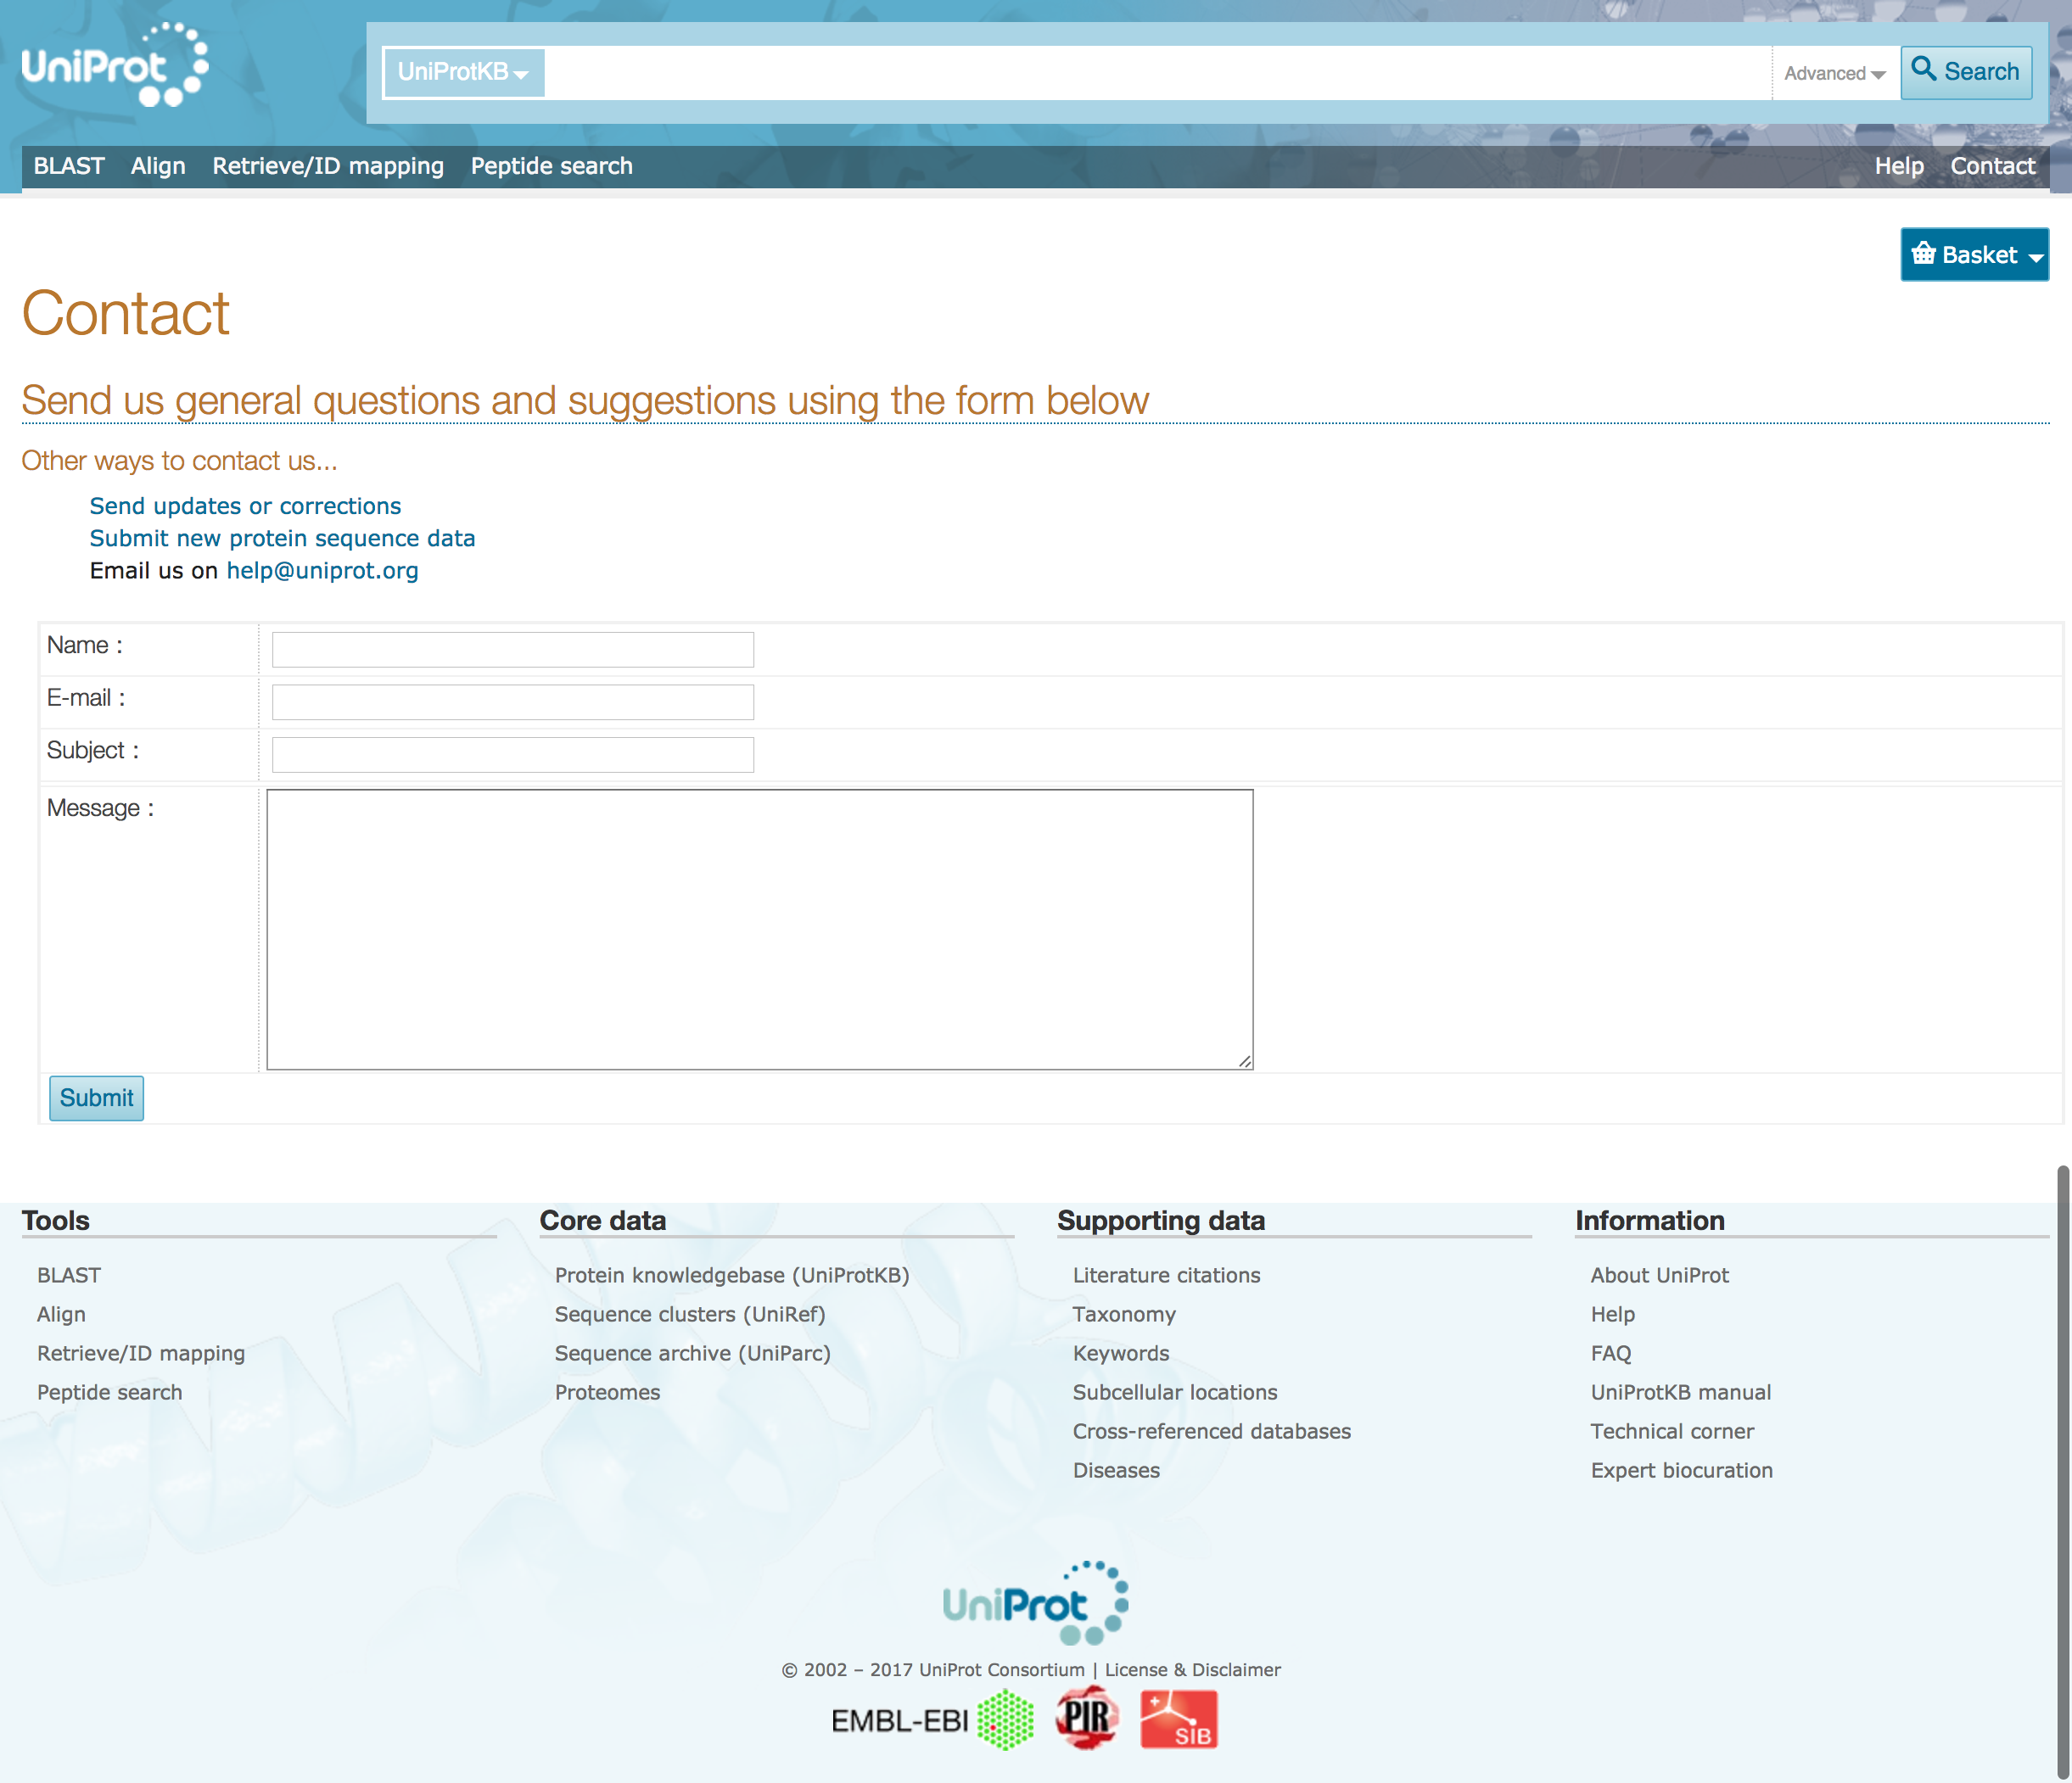
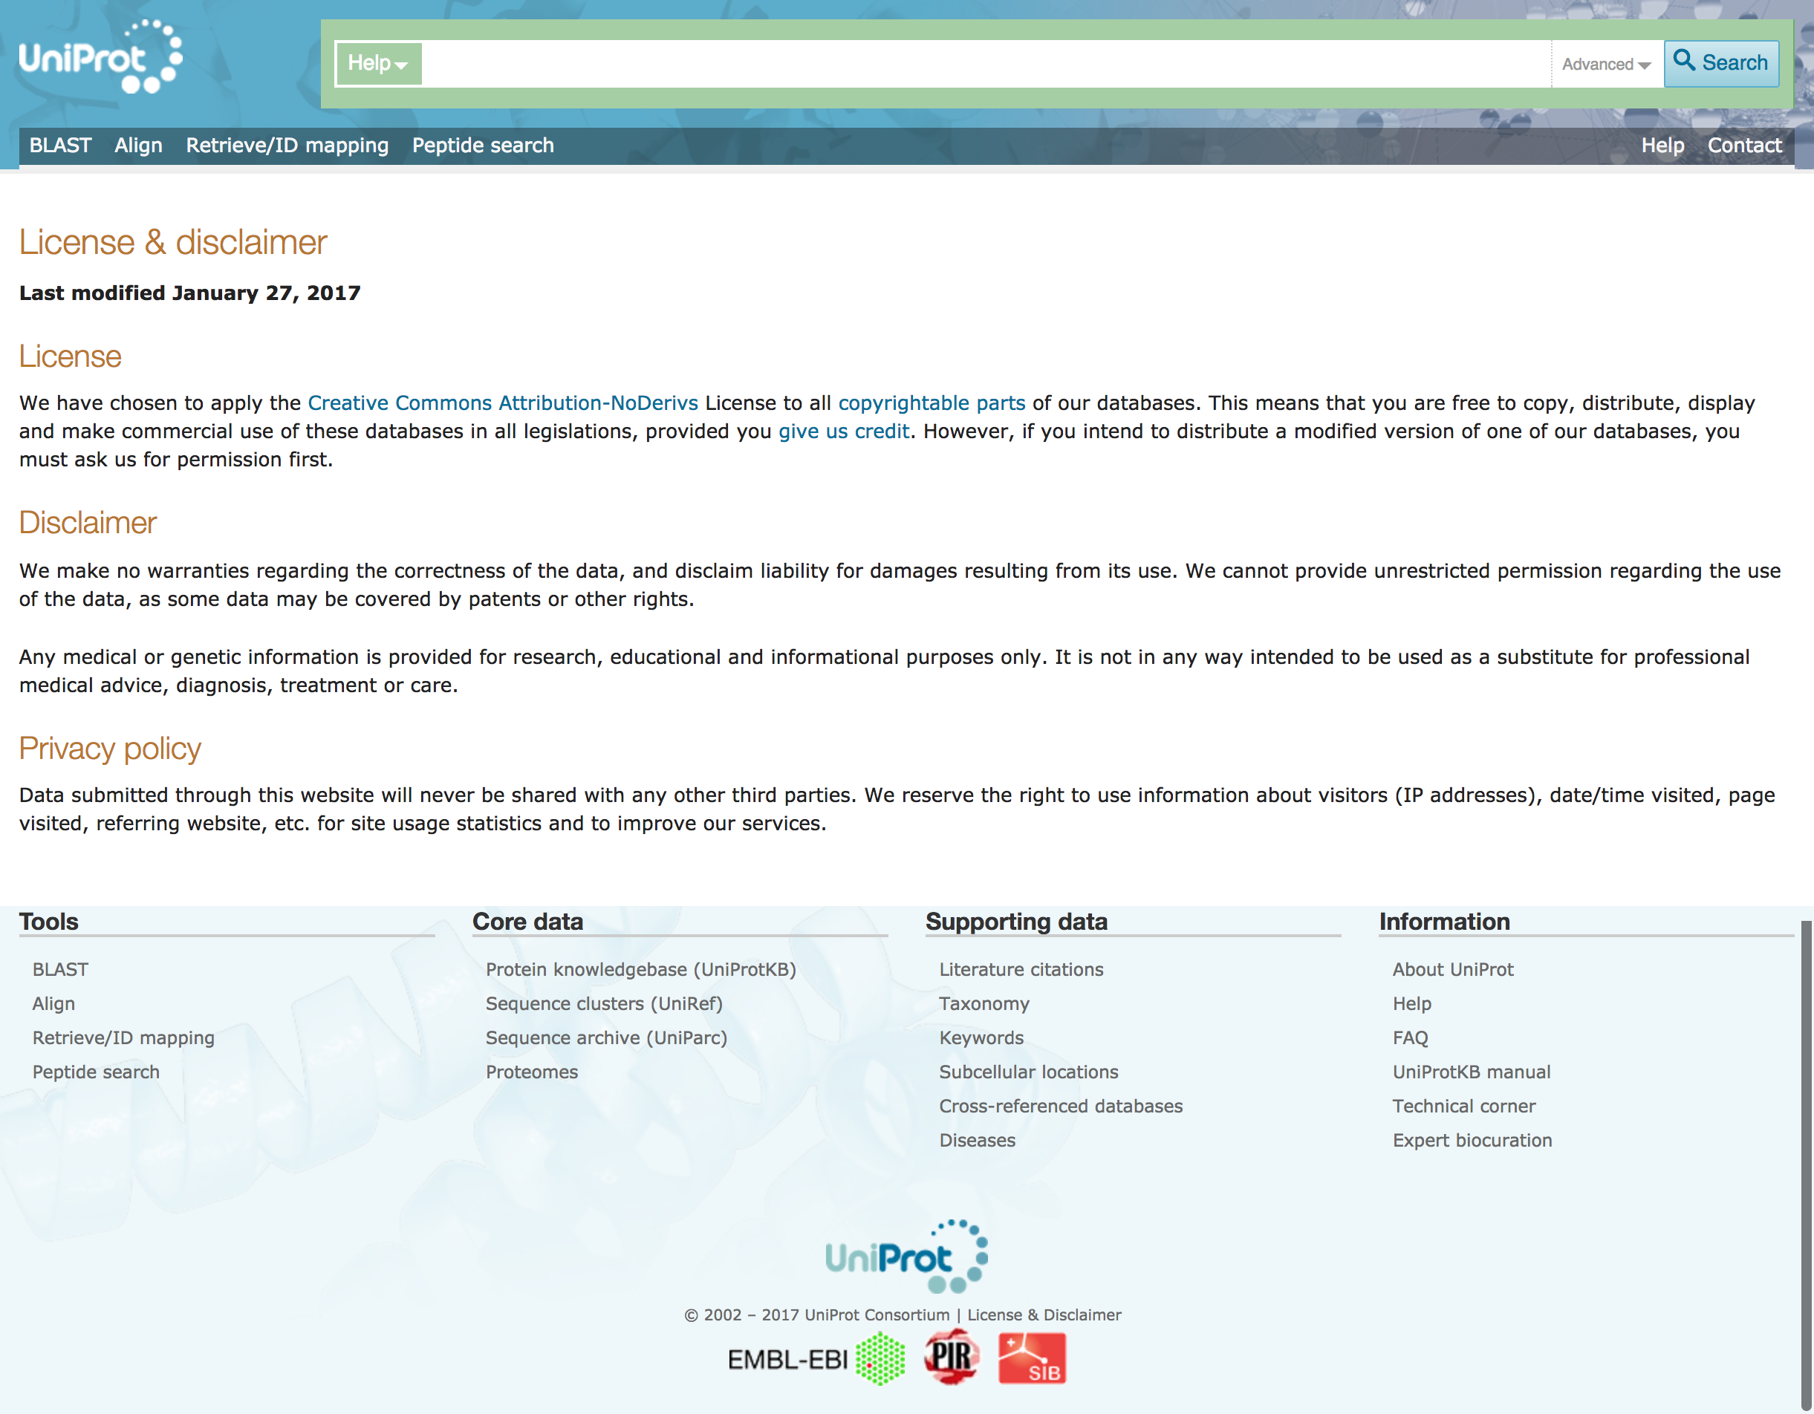
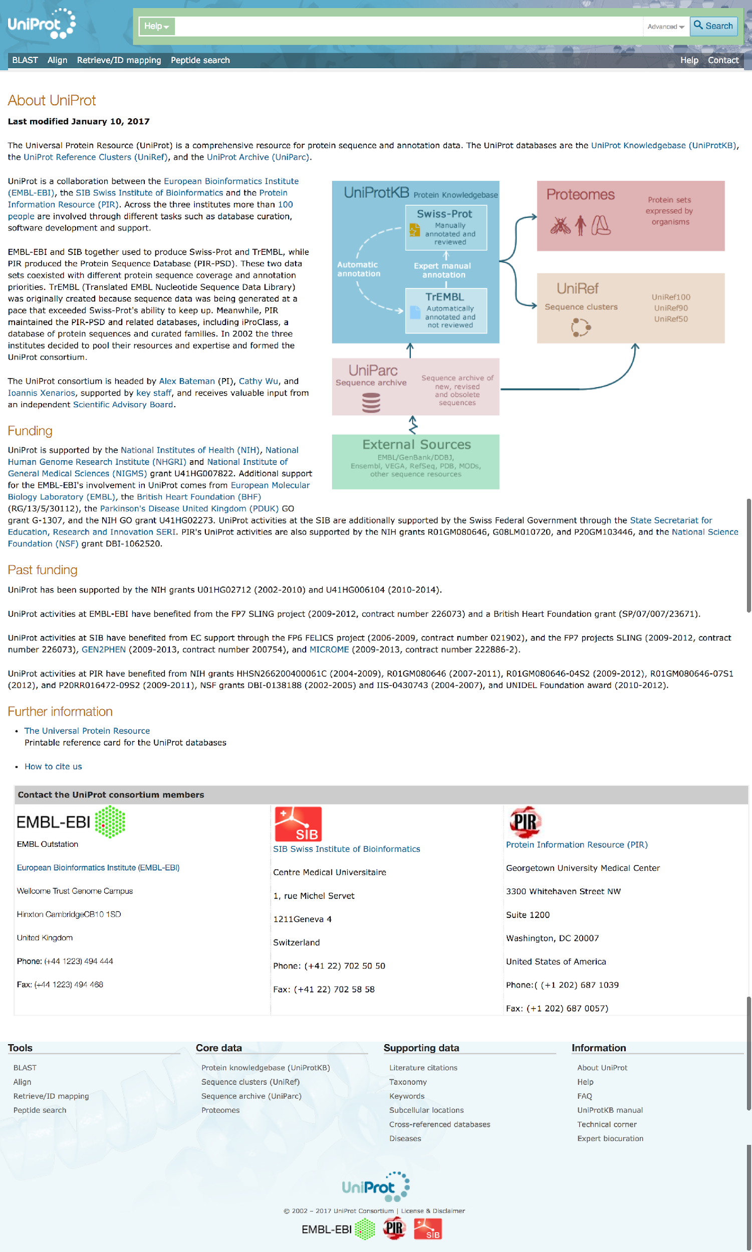
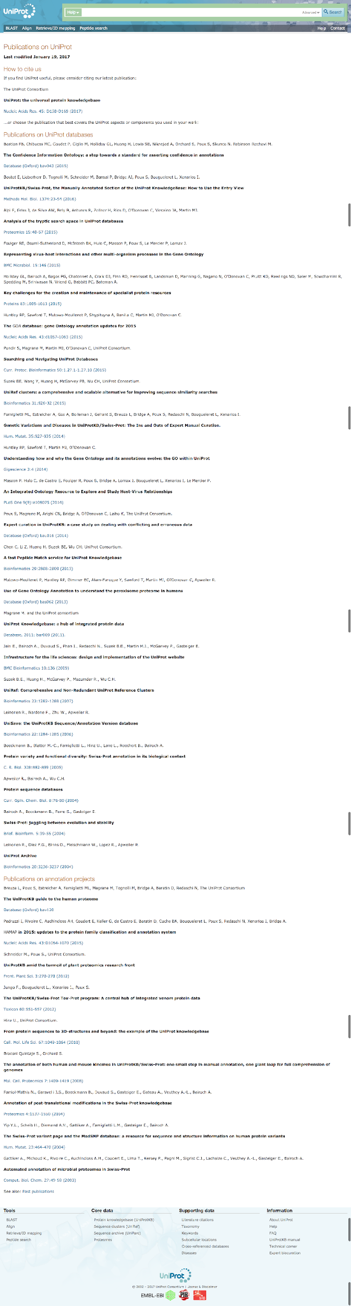
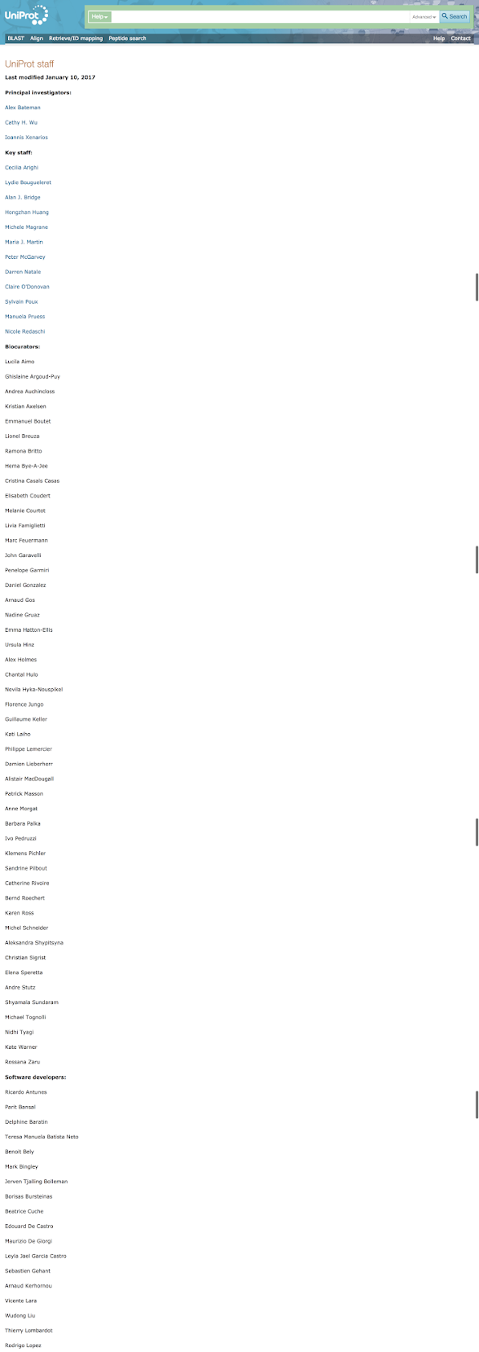
Description
Download
APIs
Release
Metrics
…
Contact
License
Funding
Citations
Authors

Slide 5



Registries of Data repositories
…
Identifier.org
Bio.tools

Slide 6
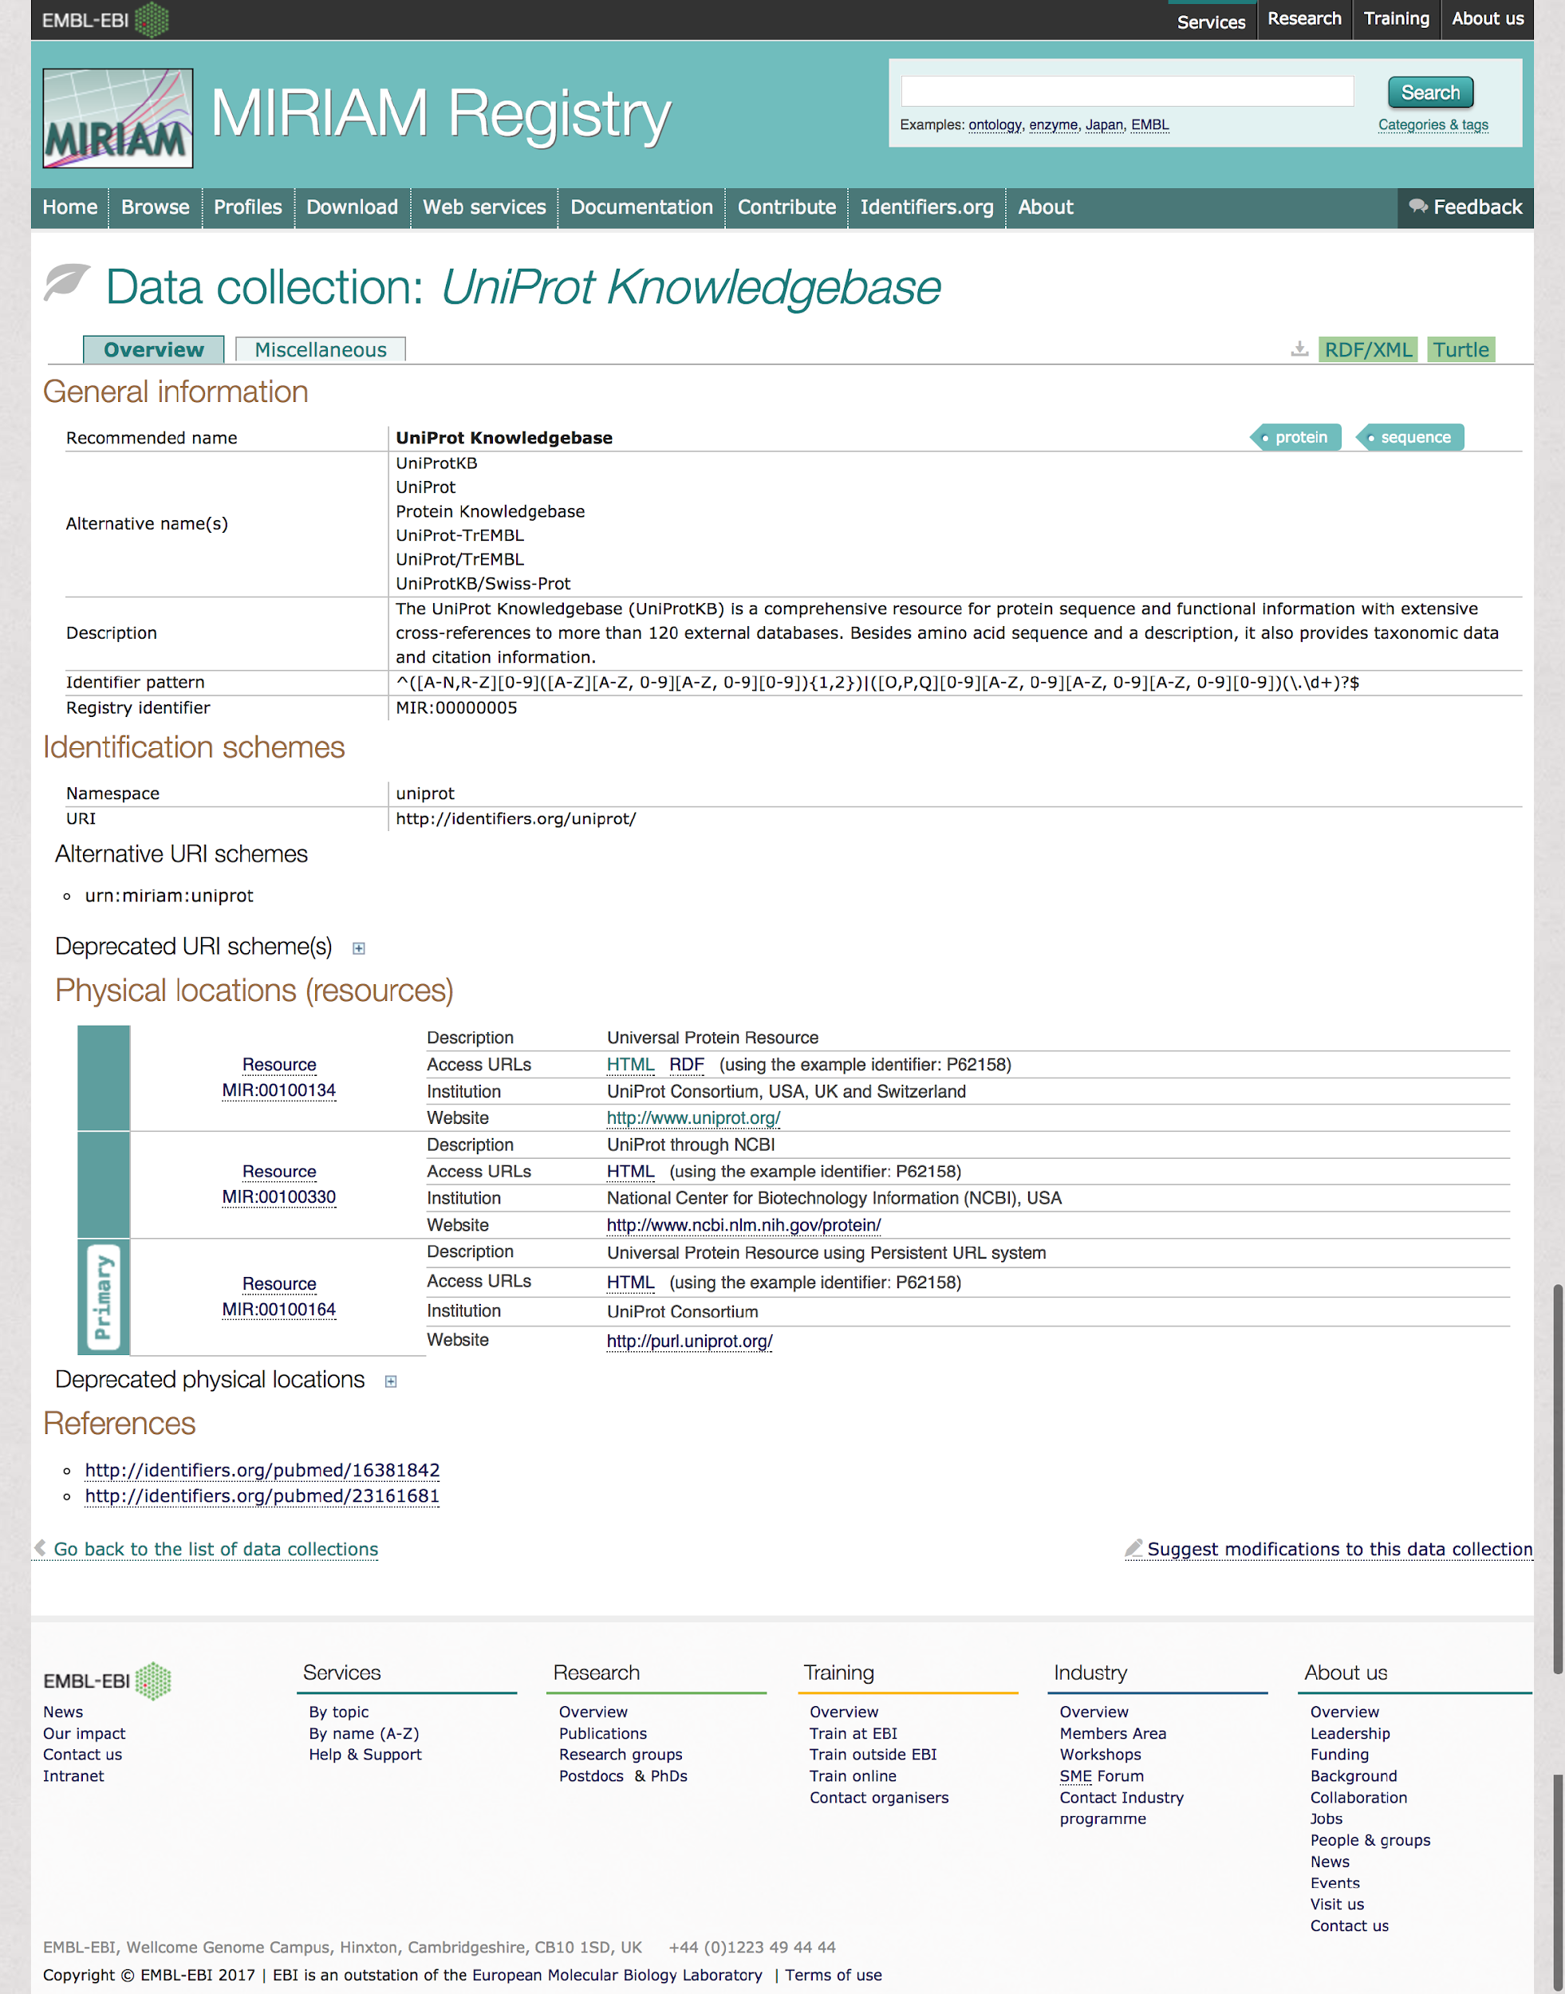
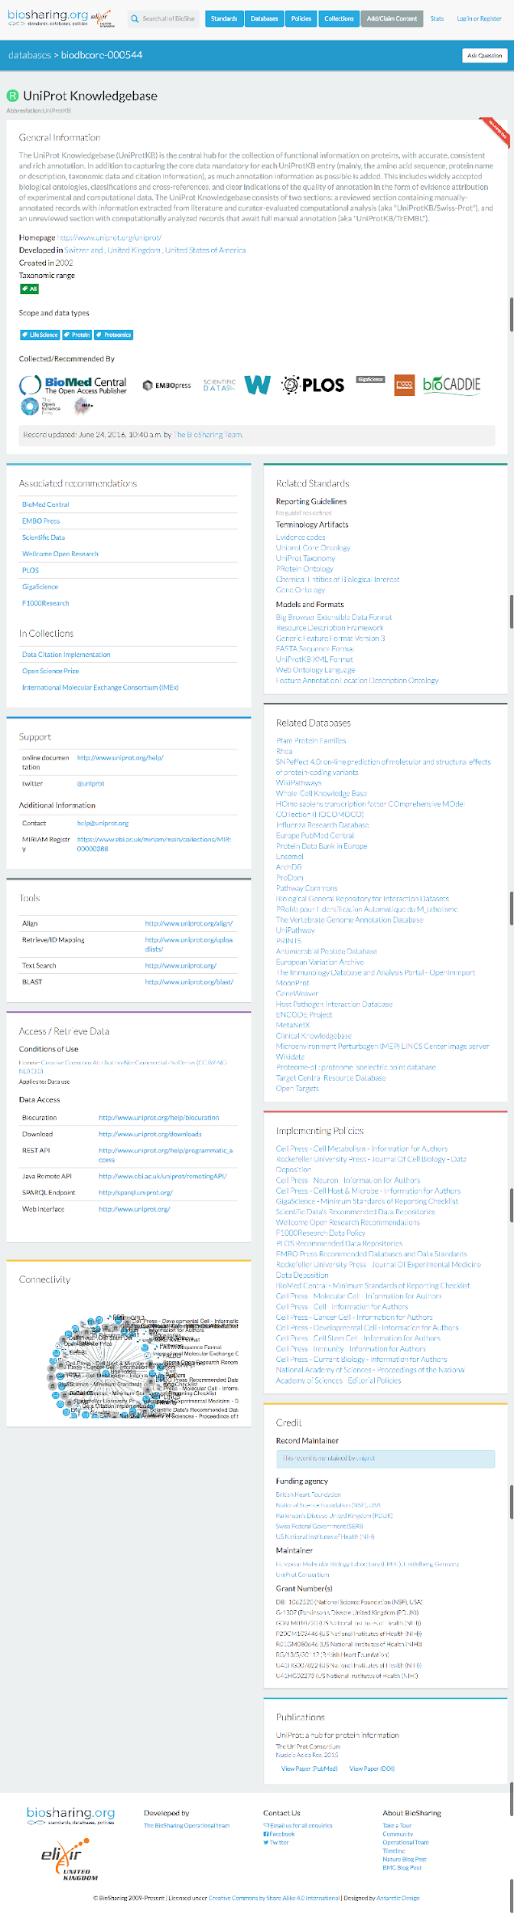
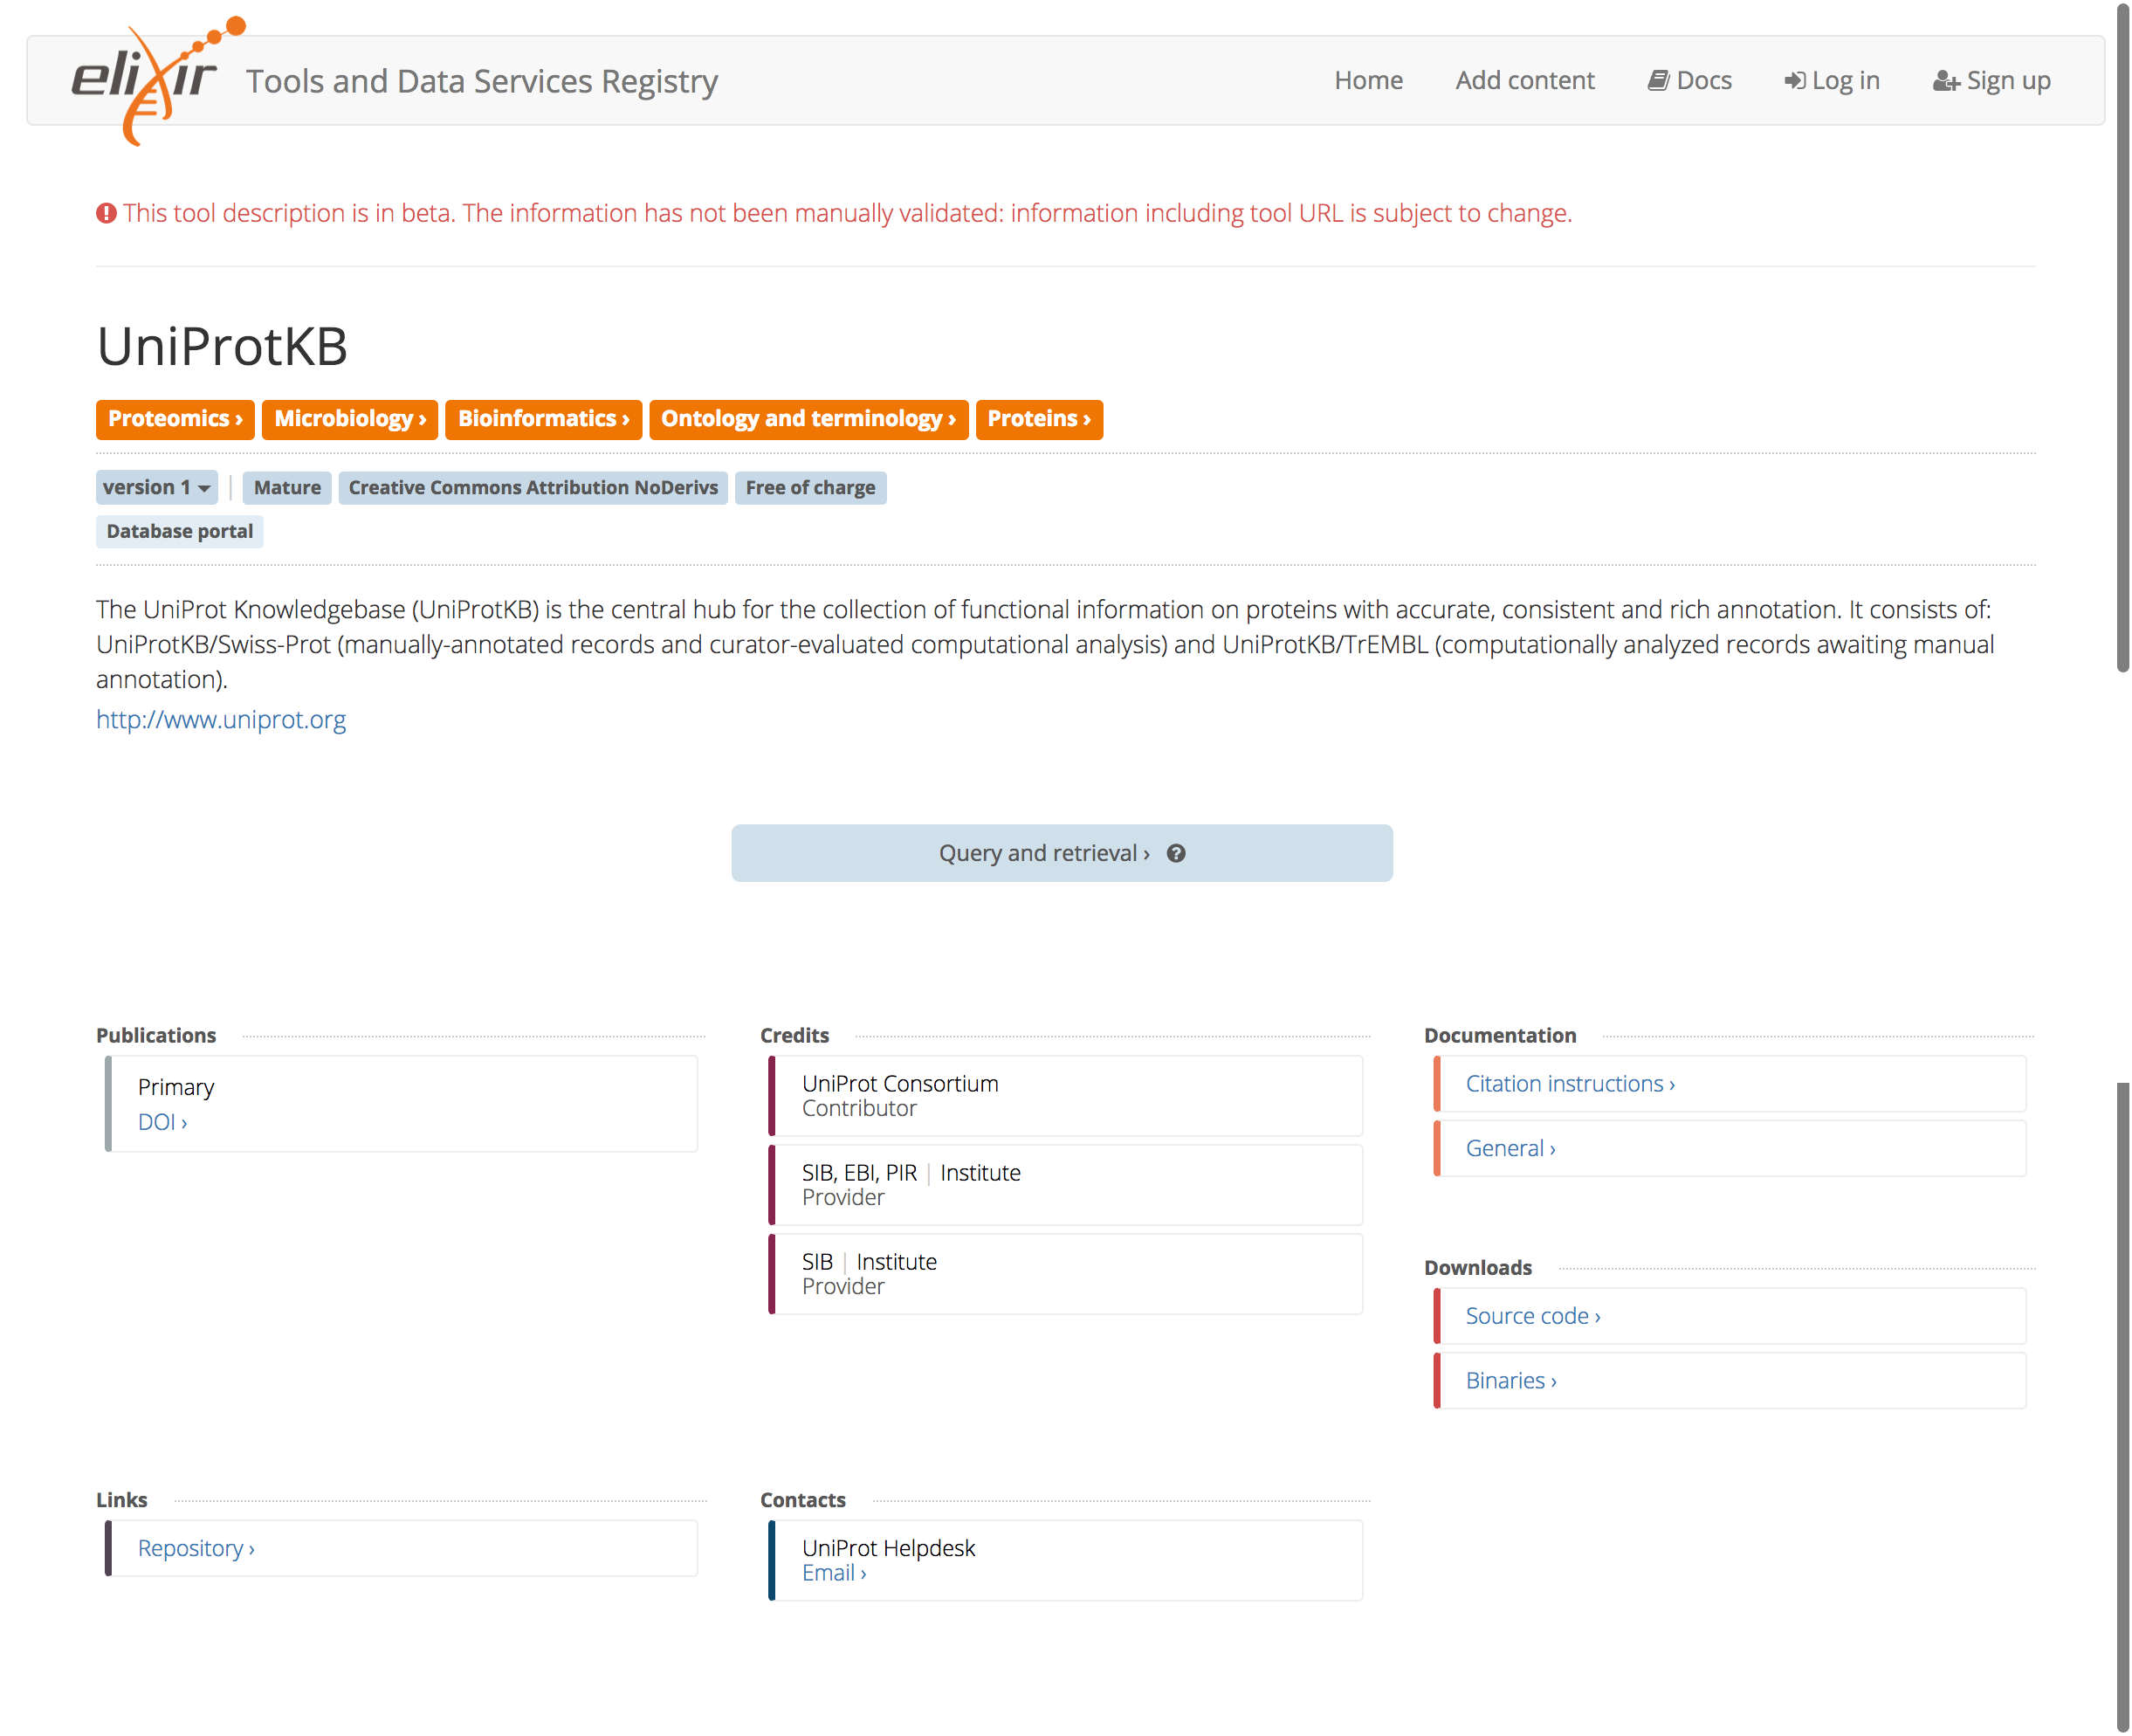
…
Identifiers.org
Biosharing
Bio.tools

Slide 7
Data repositories metadata
Citation
Identifiers
Release
Metrics
Tools
Interfaces

Slide 8
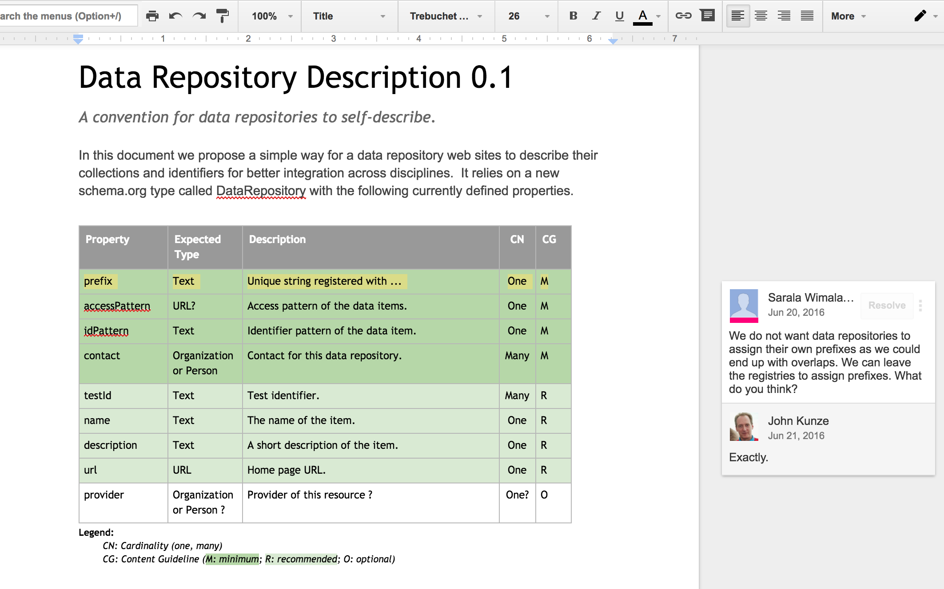
Identifiers

Slide 9
Problem
Most Life sciences data repositories are missing a home page providing information about themselves with consistent structured data that would help search engines and registries to index them.
Several registries (eg. biosharing, bio.tools, identifiers.org, ...) maintain overlapping efforts to collect certain metadata (eg. title, description, keywords, ...) about “data repositories” (eg. UniProt Knowledgebase, Human Protein Atlas, Protein Data Bank, ...)
Most of these registries have a manual curation process
There is lack of consistency between the metadata collected by these registries

Slide 10
Objectives
Describe data repositories using Bioschemas compliant markup so data repositories can be more easily indexed by search engines and registries.
Evaluate how registries should collect structured metadata exposed by data repositories to facilitate an automatic or semiautomatic update their records and present more consistent descriptions.
Explore how to collect structured metadata for some of the metrics proposed by the ELIXIR data platform.

Slide 11
Milestones
1.M1 - Identify needs and define technical use cases
Describe and justify use cases. Potential use cases are: identifiers, access interfaces, citation, data release reports, metrics, ...
1.M2 - Analysis and mapping of metadata already used in existing registries and data repositories.
1.M3 - Define minimum information guideline based on mapping results
Identify a minimum set of common properties
Identify domain specific properties not common but required by specific use cases
1.M4 - Test adoption and improve specification with selected data repositories
1.M5 - Test how registries could ingest structured data exposed by data repositories
1.M6 - Propose any new suggested types or properties to schema.org
ID | Subproject | Mar | Apr | May | Jun | Jul | Aug | Sep | Oct | Nov | Dec | Jan | Feb
1 | Data repositories | 1.M1 |  | 1.M2 1.M3 | 1.D1 |  |  | 1.M4 1.D2 | 1.M5 |  | 1.D3 | 1.M6

Slide 12
Deliverables
1.D1 - Bioschemas specification
1.D2 - Data repository using Bioschemas compliant markup
1.D3 - Data registry using Bioschemas compliant markup
ID | Subproject | Mar | Apr | May | Jun | Jul | Aug | Sep | Oct | Nov | Dec | Jan | Feb
1 | Data repositories | 1.M1 |  | 1.M2 1.M3 | 1.D1 |  |  | 1.M4 1.D2 | 1.M5 |  | 1.D3 | 1.M6

Slide 13
Stakeholders
Identifiers.org (2), BioSharing (2), UniProt (1), PDBe (1), Pfam (1)
Biosamples, DATS, OLS, Molgenis
Bio.Tools, COPaKB, HPA, Beacon Network, BioCatalogue, EZID/Name2thing, UKCRC Tissue Directory, TeSS, Force11 data citation group
BBMRI-ERIC Directory, BBMRI-ERIC, Data harmonization toolset (MDR..), BIBBOX, OMICsDI, transPLANT, EGA, BRENDA, EMBL-EBI search, IMPC, Biodbcore, DCAT, BBMRI-NL biobank catalogue, RD-connect sample catalogue, CHD7.org, DEB-Central.org, Gene3D, Datacite

Slide 14
Alignment with ELIXIR use cases
MaU = Marine metagenomics use case, PlU = Plant sciences use case, RaU = Rare disease use case, HuU = Human data use case, DaP = Data platform, ToP = Tools platform, CoP = Compute platform, InP = Interoperability platform, TrP = Training platform
Category | ID | Subproject | MaU | PlU | RaU | HuP | DaP | ToP | CoP | InP | TrP
Life sciences Content Types | 1 | Data repositories | x | x | x | x | x | x | x | x | x
 | 2 | Datasets | x | x | x |  |  |  | x | x
 | 3 | Beacons |  |  |  | x
 | 4 | Samples | x | x | x | x |  |  |  | x
 | 5 | Phenotypes |  | x | x
 | 6 | Protein annotations |  |  |  |  | x
Discovery and Validation | 7 | Bioschemas registry |  |  |  |  |  |  |  | x
 | 8 | Bioschemas validation |  |  |  |  |  |  |  | x
Community Support | 9 | Project and community coordination |  |  |  |  |  |  |  | x | x

Slide 15
References
06- Automating the collection of “data repositories” metadata
03- Data release reports with Schema.org
Data repositories draft specification

